Slide 1
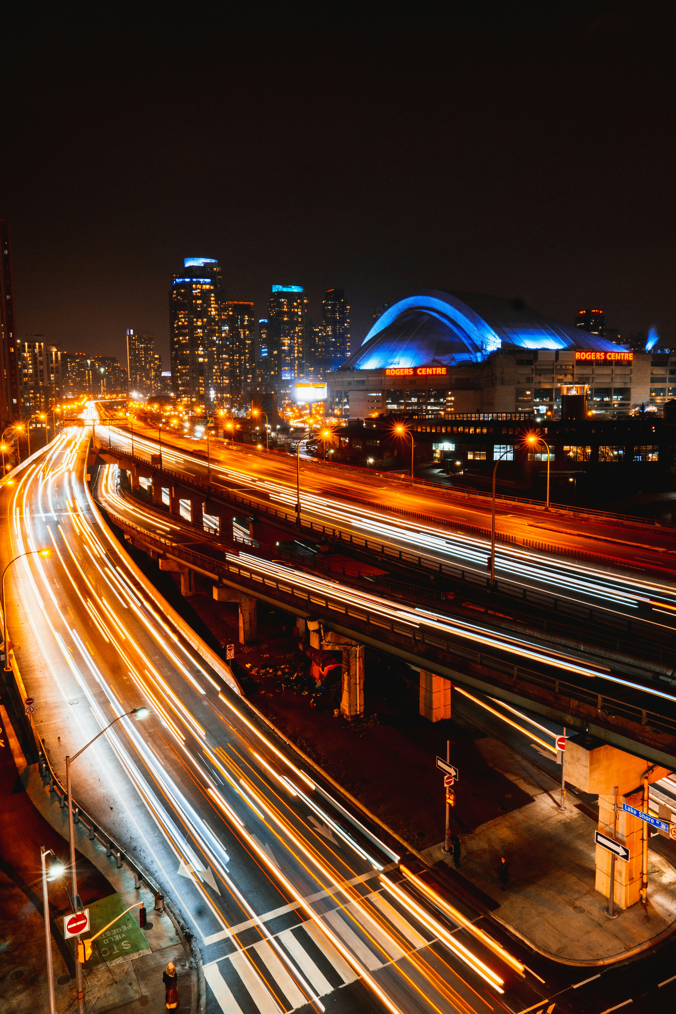
Travelling Salesperson Problem
Emilia Lubanska
Artificial Intelligence course

Slide 2
Problem Space
The Travelling Salesperson Problem (TSP) is a classic optimization challenge in which a salesperson must visit a series of cities, each exactly once, and return to the starting point while minimizing the total distance traveled. This project focuses on a real-world application of the TSP in Southern Ontario, where a salesperson must visit the 10 largest cities, starting and ending in Toronto, using AI tools to optimize the route for minimum travel time or distance.
Key Goals:
To create an optimized route for a salesperson who needs to visit the 10 largest cities in Southern Ontario by car within one week (5 business days).
To minimize total travel distance or time while ensuring the salesperson starts and ends in Toronto.
Constraints:
Timeframe: The salesperson has one week (7 days) to complete the journey, implying a need for overnight stops and an efficient daily schedule.
Start/End Point: Toronto serves as both the start and end city.
Driving Mode: The journey is conducted by car, so travel distances between cities must account for real-world road networks and traffic conditions.
City Order: The salesperson must visit each city exactly once before returning to Toronto.

Slide 3




Tools Used
ChatGPT (data set generation, Python code)
Adobe FireFly (image creation)
Microsoft Designer (image creation)
NotebookLM (documents and articles summary)

Slide 4
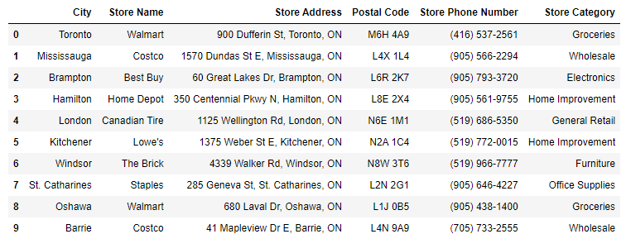
Successful Prompts
Can you please generate prompt for chat GPT to generate data sets of 10 big box stores in top 10 biggest cities in Southern Ontario.
Generate a dataset of 10 big box retail stores in the 10 largest cities in Southern Ontario. Each row of the dataset should include the following information:
City Name
Store Name
Store Address
Postal Code
Store Phone Number
Store Category (e.g., electronics, groceries, home improvement, etc.) The cities to include are: Toronto, Mississauga, Brampton, Hamilton, London, Kitchener, Windsor, St. Catharines, Oshawa, and Barrie.

Slide 5
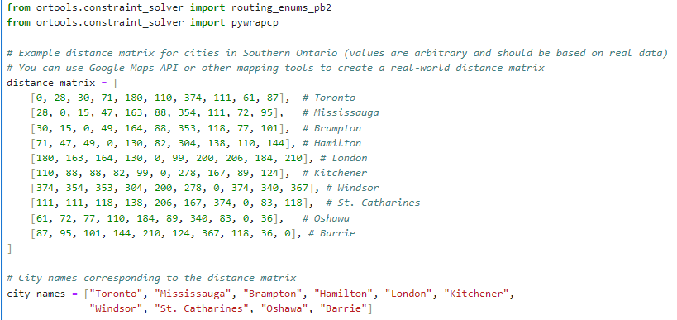
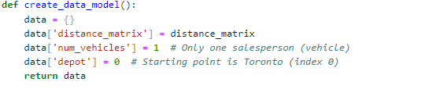
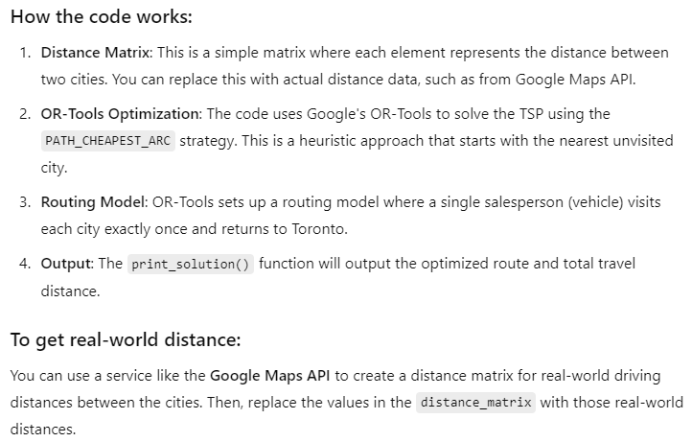
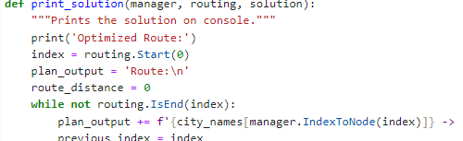
Successful Prompts
Step 1
ChatGPT Prompt:
Having previously generated a data set, please generate Python code that calculates the optimized route for a salesperson who needs to visit the 10 largest cities in Southern Ontario by car within one week (5 business days). To minimize total travel distance or time while ensuring the salesperson starts and ends in Toronto.
Step 2 – defining data model and routing problem
Step 3 – printing results

Slide 6
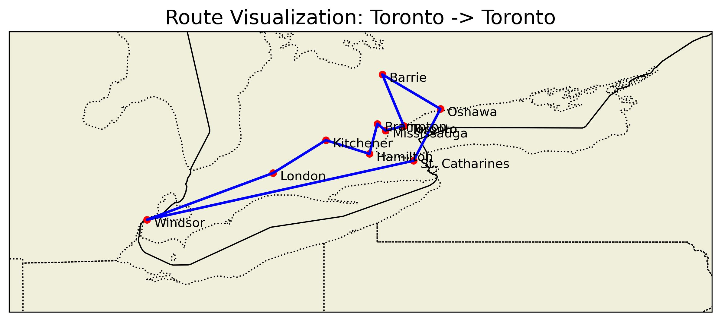
Your Project Deliverable

Slide 7
Challenges & Highlights
1. Code generation
Missing libraries – need to reinstall Anaconda to newer version
Route visualisation – ChatGPT suggested to use Geopandas, but this did not work for me
pip install cartopy geopy matplotlib
Next suggested solution was using Cartopy library
Cartopy worked well, but with limitations

Slide 8




Challenges & Highlights
2. Image generation
Adobe Firefly vs Microsoft Designer (free)
Prompt 2: “Create an realistic image that illustrates the classic traveling salesperson problem. Salesperson will be travelling to the 10 biggest cities in the Southern Ontario, starting from Toronto”
Prompt 1: “Create an image that illustrates the classic traveling salesperson problem.”
Adobe Firefly
Designer
Adobe Firefly
Designer

Slide 9
Reflection
I was able to create very basic model using Generative AI
Next time use Google API to calculate distances and using real world roads map
Model should also take into consideration time spend in the store and traffic
AI tools have been really helpful – no need to write code from scratch
Would like to try ChatGPT alternative – Claude

Slide 10


